Slide 1
NE 591: Advanced Reactor Materials
Fall 2021
Dr. Benjamin Beeler

Slide 2
Last Time
Key thermophysical properties includes thermal conductivity, CTE, creep, etc., and vary strongly based upon composition
Two primary phases: UC and U2C3
Three stages in burnup that affect centerline temperature
Fuel restructures into typically three zones with variable porosity
Carburization of cladding is the key FCCI phenomenon
Control of C/M ratio via initial hyperstoichiometry prevents low melting metal phases forming
Carbothermic reduction is primary fabrication route

Slide 3
Nitride Fuels
Nitride fuel has been proposed as an advanced fuel for fast reactors and developed since the 1960s and tested in the BR-10, FFTF, and EBR-II reactors
Nitride fuel is a solid solution of uranium mononitride (UN) and plutonium mononitride (PuN), in which the Pu/(U+Pu) molar ratio ranges from 0.15 to 0.25
Nitride has also been proposed as a fuel for space reactors
UN, PuN, and minor actinide mononitride (U,Pu,MA)N, has been proposed as one of the candidate fuels for Gen IV-type fast reactors
U-free nitride fuel, such as (Pu,MA)N diluted by ZrN, has been studied for MA transmutation accelerator driven systems

Slide 4
Nitride Fuels
Higher fissile density: 40% more uranium in UN than in UO2, leading to higher conversion ratios, and potentially higher burn-ups
Higher thermal conductivity: reduction of the fuel centerline temperature, increase in the margin for fuel melting, delay the migration of fission products and actinides
Reprocessing: readily dissolve in nitric acid (HNO3), making this fuel compatible with the PUREX process
Stability: chemically compatible with most potential cladding materials, good irradiation stability
Potential for longer fuel cycle: neutronic behavior of UN can extend cycles from 18 to 25 months, reducing costs and down time

Slide 5
Drawbacks of Nitrides
Fabrication: the production of minor actinide (or even plutonium) containing nitride fuel is not straight forward and require some difficult production steps
Oxidation resistance: the nitride pellets readily oxidizes in superheated steam
Nitride powder is pyrophoric, requiring strict atmospheric controls during fabrication and handling
Fuel enrichment: the nitrogen component has to be highly enriched in ¹⁵N to increase the neutron economy and avoid the (n, p) formation of ¹⁴C from ¹⁴N, which significantly increases costs
Fuel fabrication and N enrichment have led to slower development of MN fuels than MC fuels

Slide 6
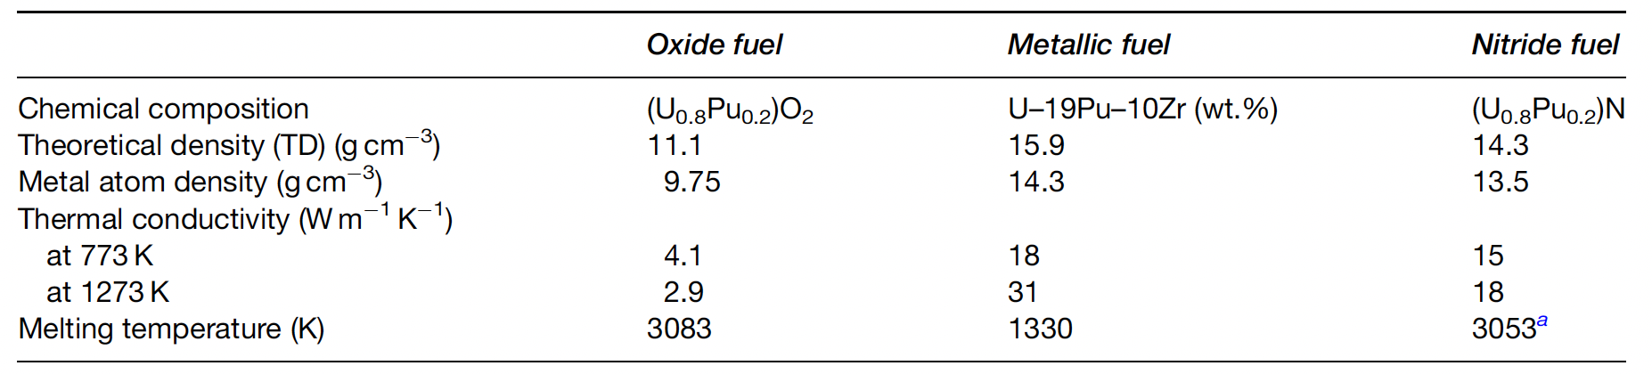
Nitride Properties

Slide 7
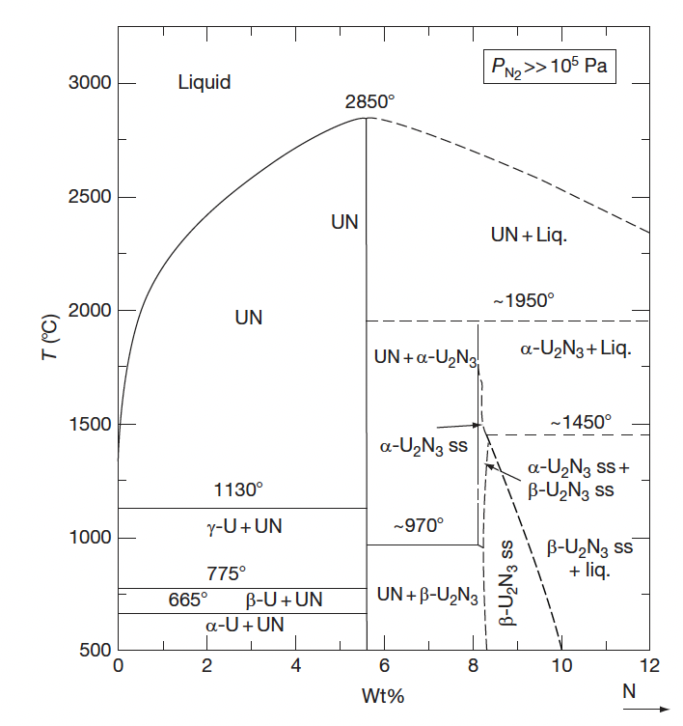
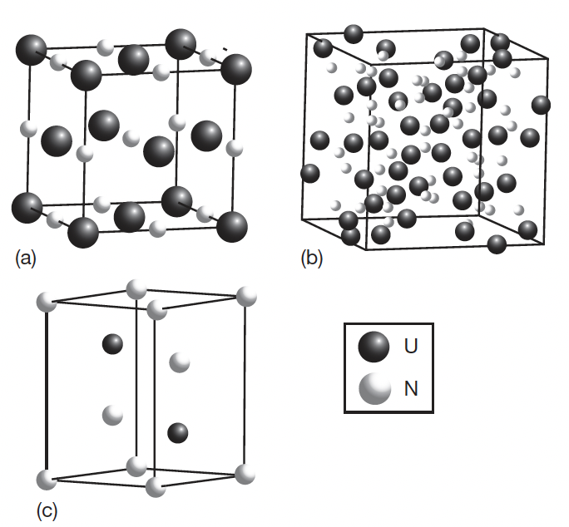
UN Phase Diagram
UN
Alpha-U2N3
Beta-U2N3

Slide 8
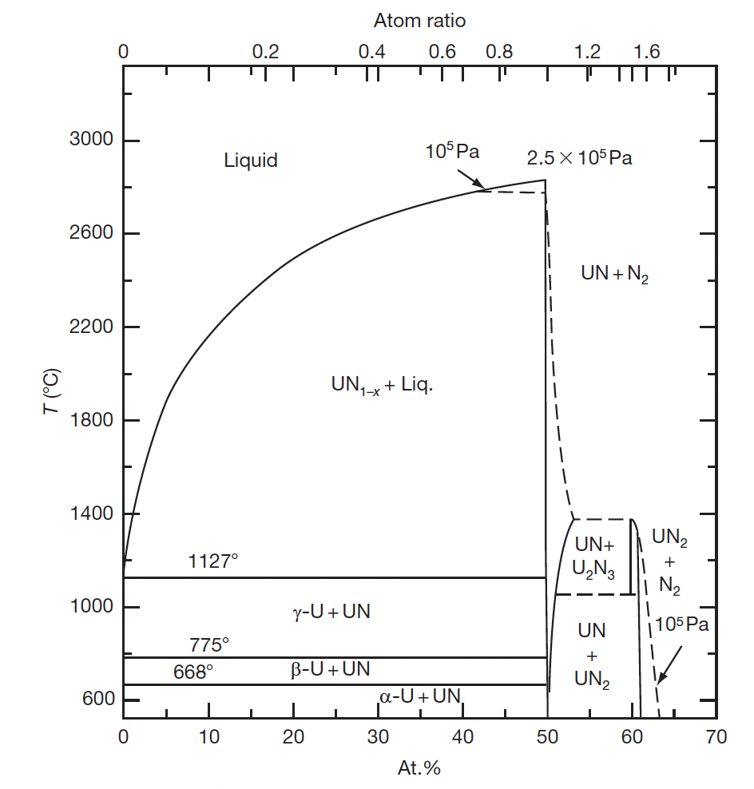
UN Phase Diagram
Where nitrogen pressure is greater than 10⁵ Pa, UN melts at 3123K and that UN and U2N3 have a wide range of nonstoichiometry
At lower nitrogen pressure (<2E5 Pa) UN decomposes such that UN and U2N3 have little nonstoichiometry
At low P_{N}, the beta-U2N3 phase changes to UN2
U2N3 decomposes to UN, and UN decomposes to U and nitrogen at nitrogen pressure below 2.5 atm

Slide 9
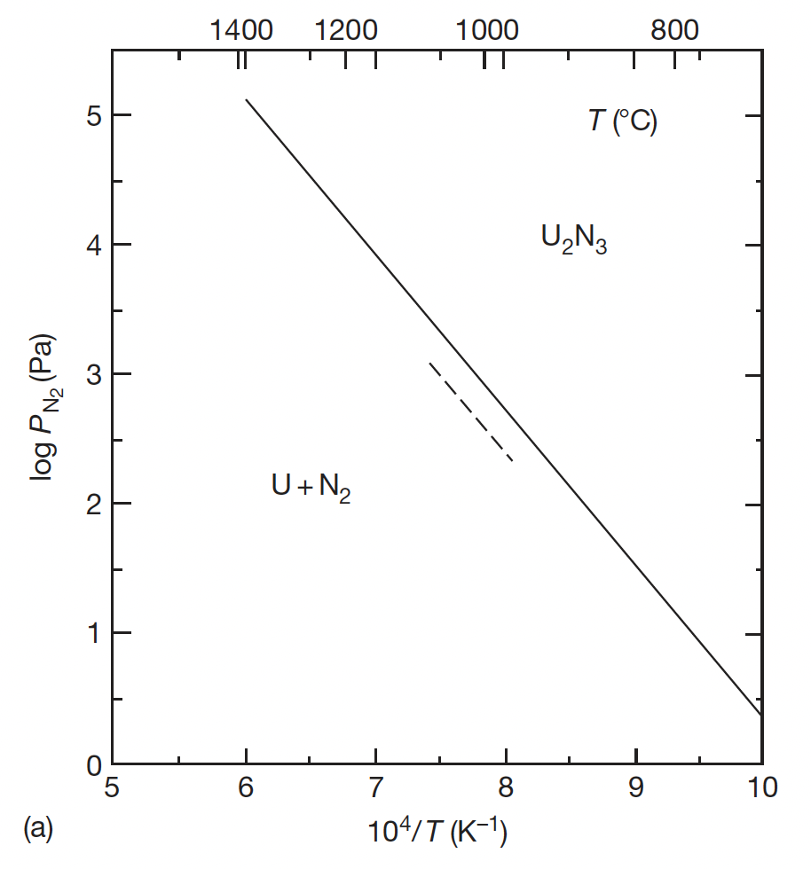
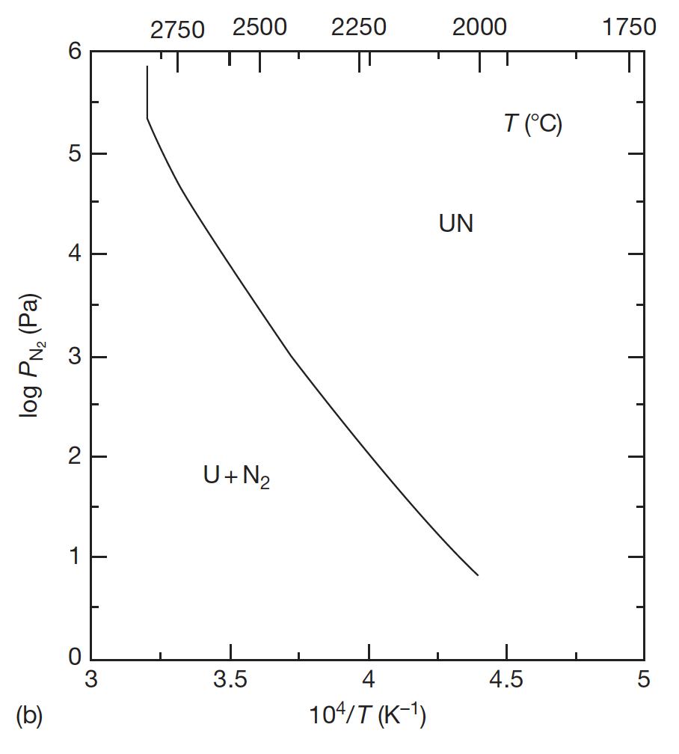
UN Decomposition
The decomposition of U2N3 is the last stage in the formation of UN through carbothermic reduction, thus the equilibrium nitrogen pressure of UN and U2N3 is very important from the viewpoint of their use as nuclear fuels
UN decomposes at 3073K and U2N3 decomposes 1620K at nitrogen pressure of 1 atm

Slide 10
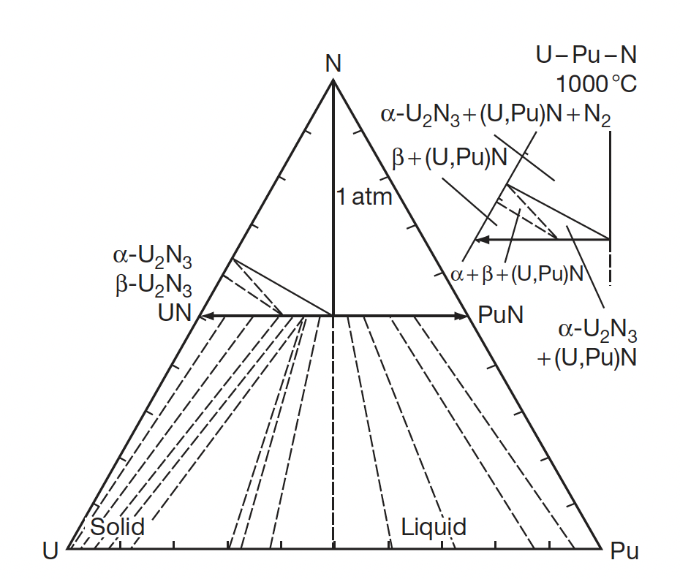
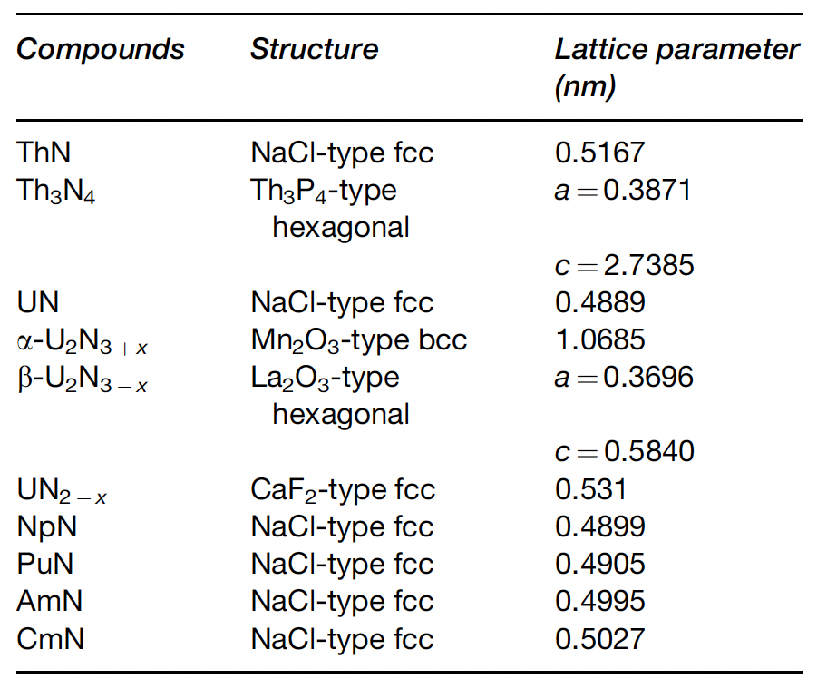
MN Crystal Structure

Slide 11
Ternary U/Pu-N
The ternary system is characterized by a complete solubility of UN and PuN
The (U,Pu)N phase has a narrow composition range of the N/(U+Pu) molar ratio
Although Pu2N3 does not exist in the Pu–N system, a sesquinitride phase was identified in the U–Pu–N system at a Pu/(U+Pu) molar ratio of 0.15
In a mononitride lattice with NaCl-type structure, small nitrogen atoms are incorporated into a dense face-centered cubic packing of metal atoms

Slide 12
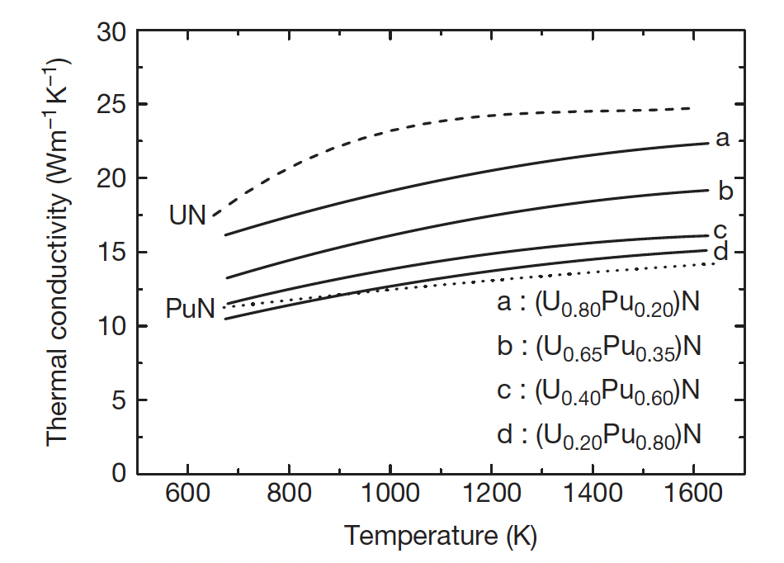
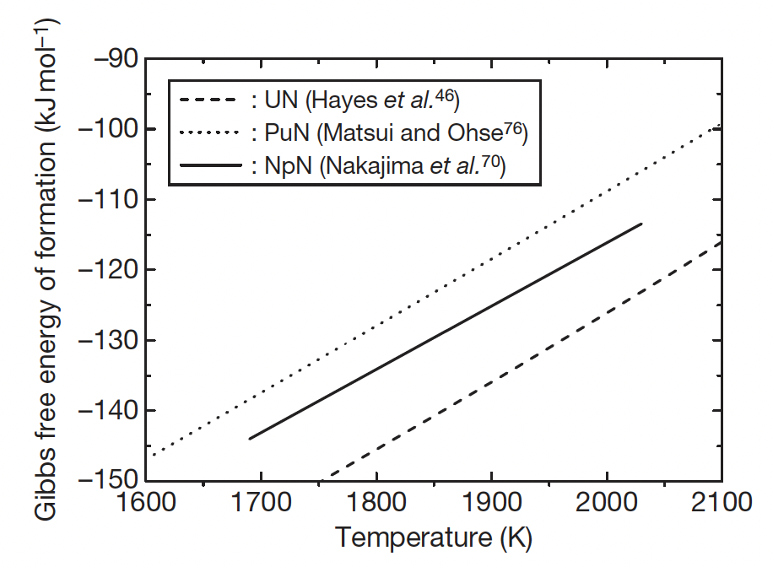
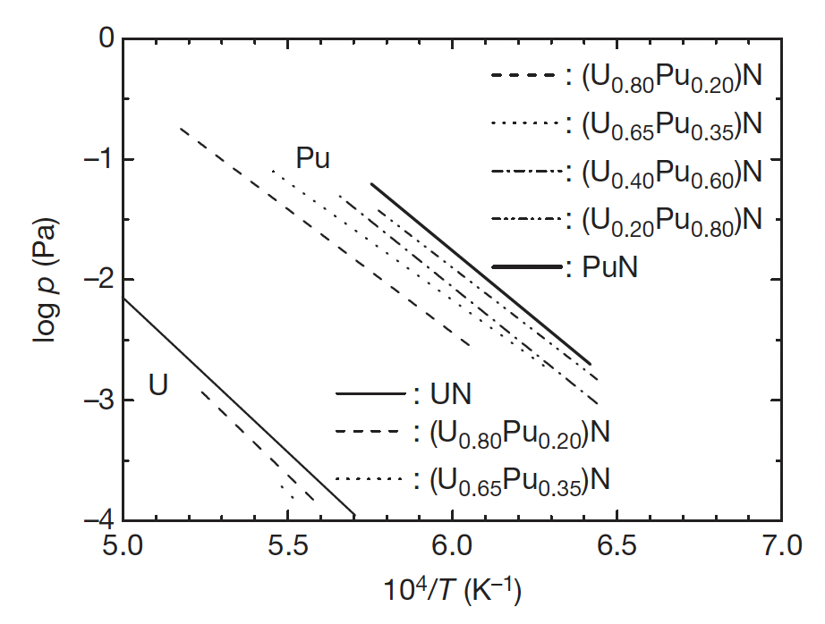
Effect of Pu on U/Pu N Properties
The addition of Pu can dramatically affect thermophysical properties
Pu is more volatile than U, and has a higher vapor pressure
Pu degrades the thermal conductivity by as much as 2X
PuN is less stable than UN, and could be susceptible to radiolysis

Slide 13
Nitride Fabrication
Similar to carbide fuels, preparation of nitrides from either metallic sources or from the hydriding-dehydriding process were explored in the 1960s and remain an option for laboratory implementation
These reactions are exothermic and should be carried out slowly by temperature cycling for better control of the products
It is difficult to apply the metal or hydride route to a technological fuel production line
These processes include the nitridation of U or Pu metal in N2 or NH3 at 1073–1173 K, arc-melting of U or Pu metal under N2 pressure, nitridation of fine-grained U or Pu powder formed by the decomposition of hydrides with N2 or NH3 and direct reaction of UH3 or PuH_{2.7} with N2 or NH3

Slide 14

Carbothermic Reduction
Carbothermic reduction is the most widely used process for preparing nitride fuel
The starting material is a dioxide and carbon, and the general reaction is
The mixture of dioxide and carbon is heated in N2 gas stream, usually at 1773–1973 K
An excess amount of carbon is usually added to the mixture to reduce the oxygen content
The residual carbon is removed from the products by heating in a N2-H2 stream
The initial C/MO2 mixing ratio was historically chosen at 2.2–2.5 for the preparation of UN and (U,Pu)N
For the preparation of UN and (U,Pu)N, the atmosphere is changed to Ar or He from N2 or N2–H2 to prevent the formation of higher nitrides

Slide 16
Summary

